Slide 1

Personal Technical
Portfolio Documentation

Slide 2
College name: malineni lakshmaiah womens engineering college college state: Andhra Pradesh internship domain: frontend developer
Personal Technical portfolio Documentation

Slide 3

MEET OUR TEAM
S.TEJA SRI
TEAM LEADER
N. Lakshmi prasanna
K. vahini
K. aparna​
u. Sri latha​

Slide 4
AGENDA
Introduction​
Services
Skills
Certifications

Slide 5
Contents of a portfolio
A portfolio is composed of three main elements:
Content - this includes the actual work you want to showcase and can be anything from writing samples to photographs or videos
Design - the design should reflect your personality and style while remaining professional. It should also make it easy to navigate the portfolio
Summary - a brief summary at the beginning of the portfolio will help provide an introduction to your work and give visitors a better understanding of yourself and what you have created

Slide 6
What is a Portfolio?
→Arter and Spandel-a purposeful collection of student work that tells the story of the students efforts , progress or achievement in a given area.
Student participation in selection of portfolio content
The guidelines for selection, the criteria for judging merit, and evidence of student self-reflection.

Slide 7
Types of Portfolio
Evaluative portfolio
Working portfolio
Showcase portfolio
Archival portfolio

Slide 8
Personal Technical portfolio Documentation
Evaluative portfolio:
Use to analyze a student's progress relative to program goals, objectivesor standards.
Includes work samples, anecdotal records, reading/writing logs, checklists, tests data and parent comments.
Working portfolio:
An evolving repository of student thoughts, ideas, growth, and accomplishment
Work examples are chosen by both teacher and students
Highlights the ongoing process of learning, not just the finished

Slide 9
Personal Technical portfolio Documentation
Showcase portfolio :
Only includes the student's best work.
Work in progress in not included.
Intended to motivate students through complete finished products.
ln isolation, it is not adequate to guide instruction.
Archival portfolio:
Gives the student's next teacher a 'snapshot' of student's developing abilities.
ltems are selected because they provide a summative record.
Intended to guide next year's teacher with planning appropriate instruction

Slide 10
Previous projects
Personal Technical portfolio Documentation
Heart beat monitoring using pulse rate sensor
Weather Prediction.
This simple project involving Arduino UNO and heartbeat sensor Modules is designed here which can calculate the heart rate of a person. It can be used as an inexpensive alternative to smart watches and other expensive heart rate monitors
The Weather Prediction App is a user-friendly and reliable application designed to provide real-time weather forecasts and updates to users. It allows users to access accurate weather information for their current location or any specified location worldwide . The app offers a visually appealing and intuitive interface, making it suitable for

Slide 11





Skills and qualifications
Personal Technical portfolio Documentation
Leadership
Problem-solving
Technical skill
Interpersonal skill
Organization
I possess leadership abilities that have been sharpened through past roles where I was responsible for the teams”
I am knowledgeable in several technical areas such as progr- ammming languages that support my ambition in my field
Teamwork is one of the essential part of my daily job, and I am sensitive towards different cultures”
My proactivity allows me to plan ahead and prioritize tasks according to objectives and different deadlines
“My problem-solving capabilities have enabled me to solve difficult issues in the past, using creative and innovative solutions

Slide 12
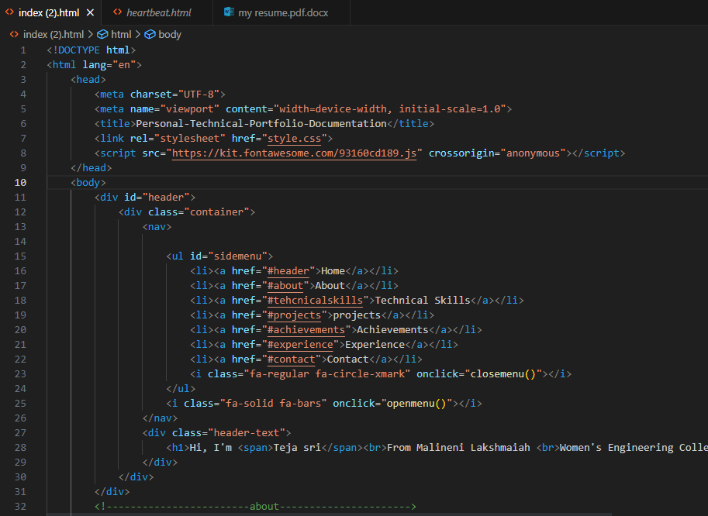
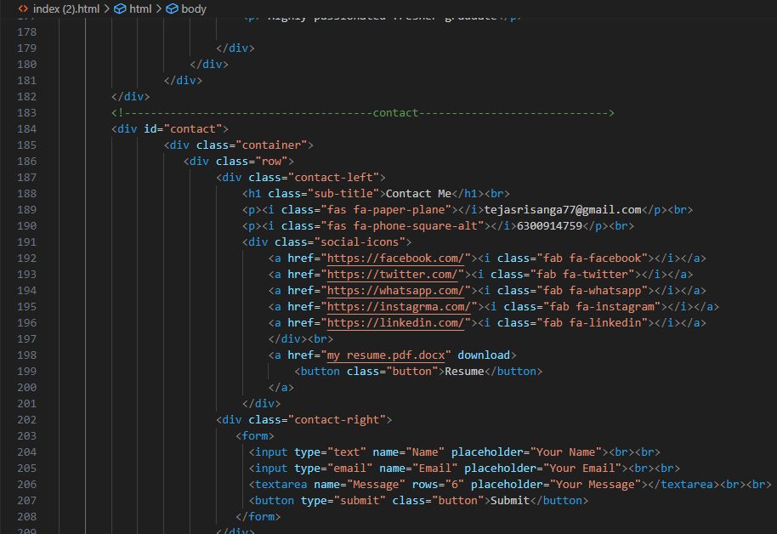
MODELING PORTIFOLIO USING HTML

Slide 13
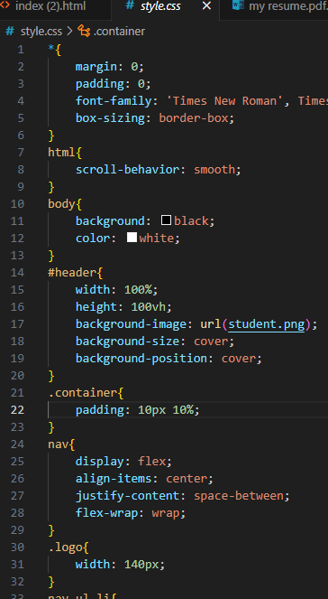
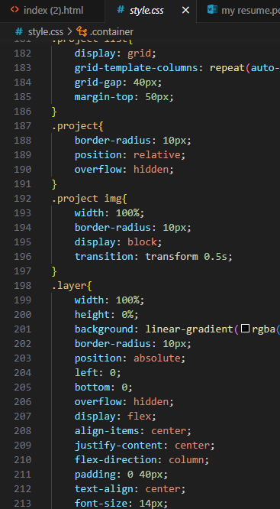
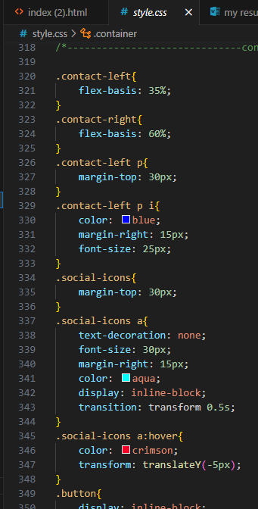
STYLING PORTFOLIO USING CSS

Slide 14
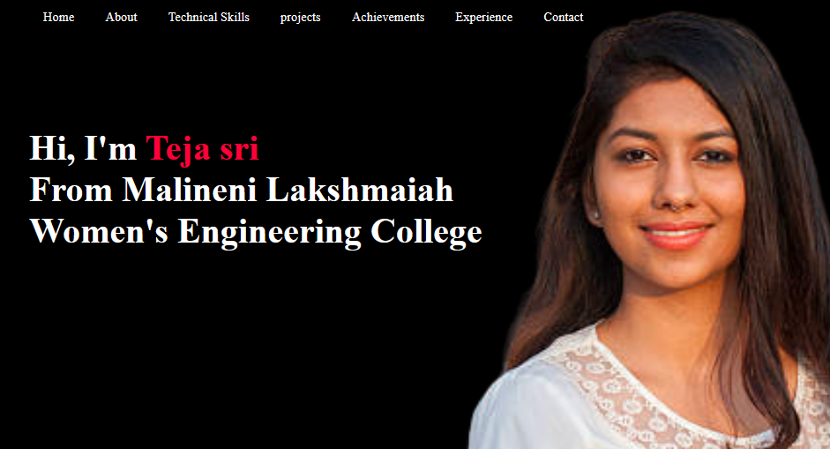
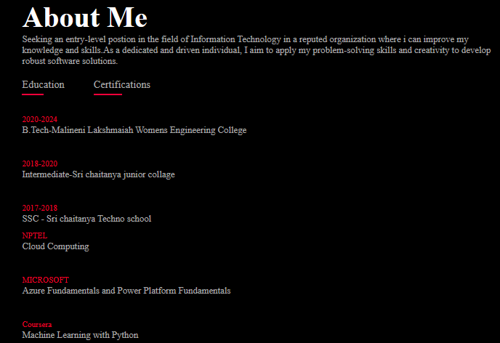
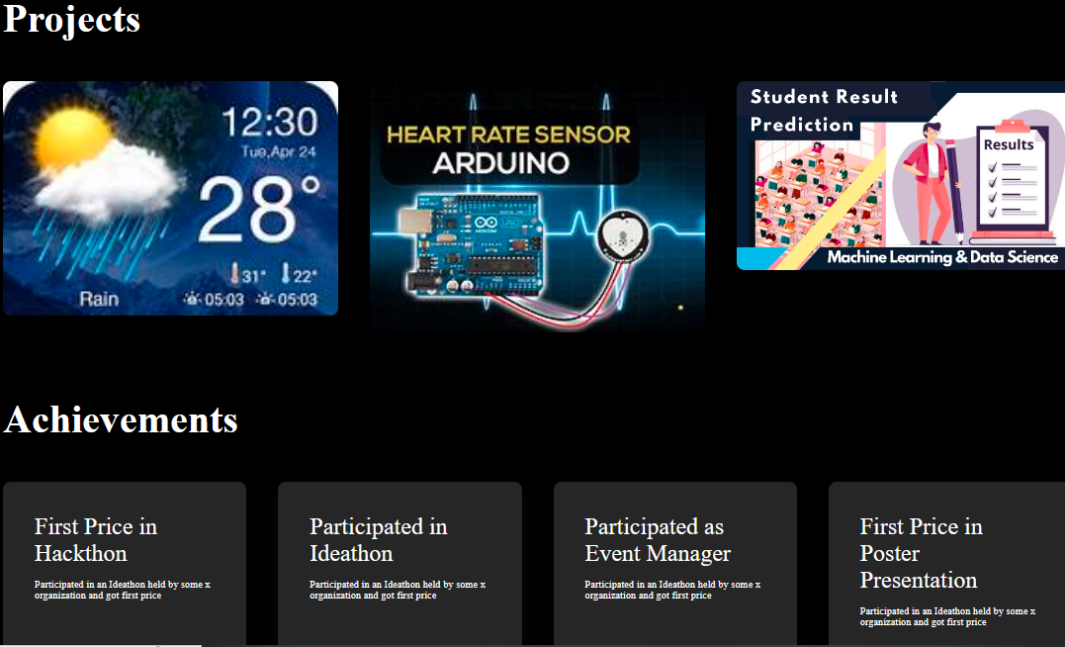

Slide 15
Resource:
https://github.com/tejasri-77/PERSONAL-TECHNICAL-PORTFOLIO-DOCUMENTATION.git

Slide 16
THANK YOU
Personal Technical portfolio Documentation
S.Teja sri
tejasrisanga7@gmail.com
(+91)6300914759

